Slide 1
KWLS CHARTS
GOOD AFTERNOON, STUDENTS!
Please use the first 3-5 minutes of class to fill out 1 “K” and 2 “W’s” on your KWLS charts about…
THE INTOLERABLE ACTS

Slide 2
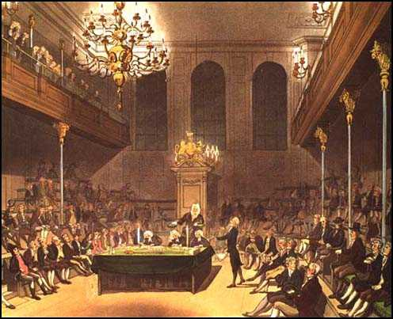
The intolerable acts 1774 (Click on title to view video)

Slide 3
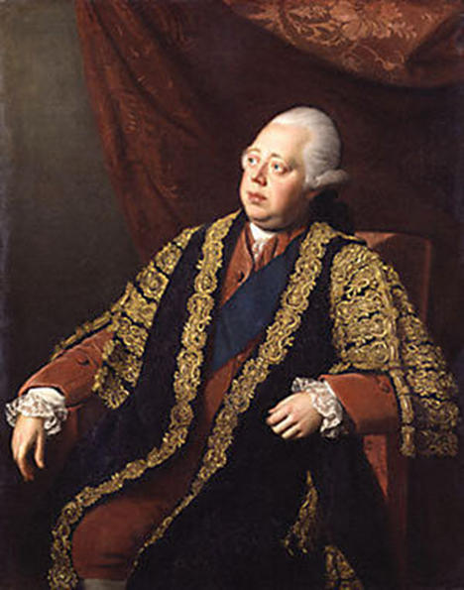
British Sentiment
"On April 22, 1774, Prime Minister Lord North defended the program in the House of Commons, saying:
"'The Americans have tarred and feathered your subjects, plundered your merchants, burnt your ships, denied all obedience to your laws and authority; yet so clement and so long forbearing has our conduct been that it is incumbent on us now to take a different course. Whatever may be the consequences, we must risk something; if we do not, all is over.'"
British Prime Minister Lord North

Slide 4
Key Facts
British Parliament responded to The Boston Tea Party by passing four laws
The colonists called these laws The Intolerable Acts.
British Parliament referred to the laws as The Coercive Acts
The Intolerable Acts were passed by British Parliament during meetings from March to June in 1774
Intended to make an example of the people of Massachusetts for their disobedience
The acts were designed to discourage other colonies from opposing British rule
A critical factor in the road to The American Revolution

Slide 5
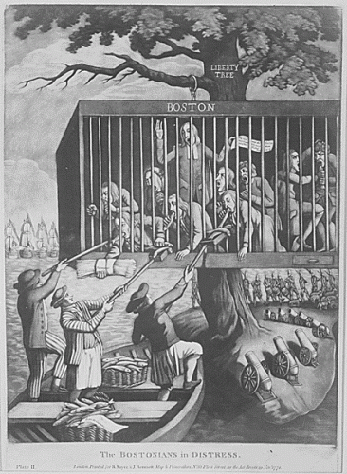
The Boston Port Act
The Boston Port Act: Closed the port of Boston until the East India Company was paid for the destroyed tea
British rational: Coerce the colonists into repaying the lost revenue caused by the Boston Tea Party
Colonial Impact: Created a great hardship for the people of Boston whose livelihood depended on trade

Slide 6
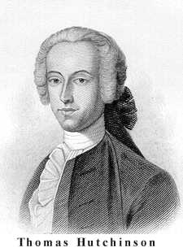
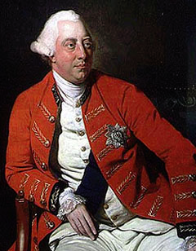
Massachusetts Government Act
Massachusetts Government Act: Took away many of the colonial rights of self-government
British Rational: It was aimed at punishing Boston and forcing it out of resistance
Almost all positions in the colonial government were appointment by the Governor or directly by the King.
Activities of town meetings were limited
Colonial Impact: Colonists of Massachusetts were angered by the infringement on their rights to act independently and freely
Governor of Massachusetts (1770-1774) Returned to England 1774
King George III (1760-1811)

Slide 7
Administration of Justice Act
Administration of Justice Act: States that British officials accused of committing crimes in a colony may be taken to England for trial
British Rational: Meant that witnesses would be forced to travel to testify (not likely)
Allowed British officials to escape justice or the punishment of Colonial America
Colonial Impact: Colonists had no leverage over the unlawful actions of British officials who now occupied most major offices

Slide 8
Quartering Act
The Quartering Act: Allowed the British to quarter British soldiers in colonial buildings at the expense of the colonists
British Rational: Constant presence of authority in colony and a cost effective means of occupation
Colonial Impact: A significant British military presence created tension due to the nature and previous use of quartering during times of war.
Could be quartered in colonists’ homes.

Slide 9
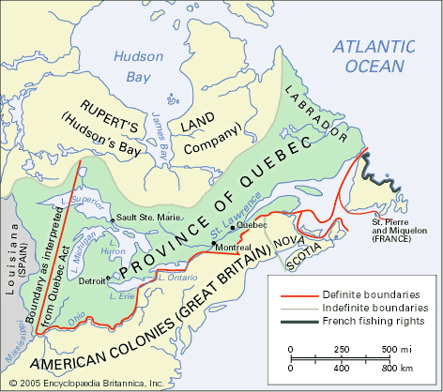
Quebec Act
The Quebec Act:
Extended the boundaries of the province of Quebec to include most of the Ohio Country.
Guaranteed colonists of Quebec free practice of Catholicism
British Rational: Appease French Canadians so as to keep them from joining the rebellious ranks of the American colonists
Was not a part of the laws passed in reaction to the Boston Tea Party (Coercive Acts)
Colonial Impact: Limited the opportunity for expansion to the West
Colonists viewed this act as one of The Intolerable Acts due in part to its stipulations and its timing
Felt as though it was a punishment

Slide 10
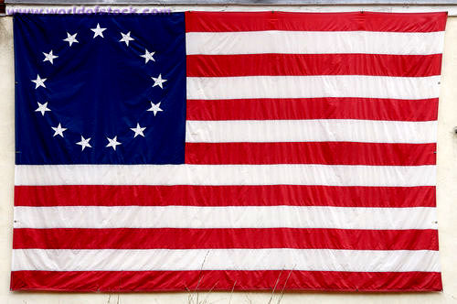
Significance
The Intolerable Acts united the colonies against Britain
Patriot leaders began to call for a meeting, or a colonial congress, to discuss the issues
Each of the colonies began to elect members to attend the congress
The colonies realized that there was nothing stopping Britain from enforcing the same laws on them

Slide 11
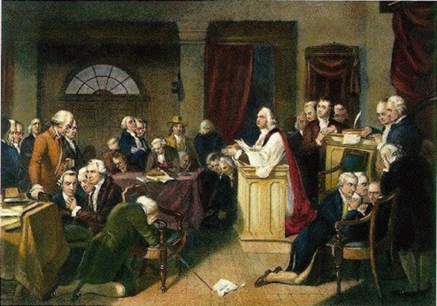
Colonial Reaction
The First Continental Congress met in Carpenter's Hall in Philadelphia, from September 5, to October 26, 1774
Major outcomes of the first continental congress to become effective on December 1, 1774 unless parliament should withdraw The Intolerable Acts:
Colonial pact of nonimportation on English goods
Colonial pact to establish a means to regulate the resistance to Great Britain
Colonial pact to keep the channels of communication open between the colonies
Final piece of major British legislation cementing the eventual outbreak of The American Revolution
First Continental Congress

